Slide 1
ERG Metrics

Slide 2
Metrics to be used for Identification
Amplitude:
The amplitude of ERG responses reflects the strength of retinal cell activation.
Reduced amplitudes may indicate dysfunction in photoreceptors, bipolar cells, or ganglion cells.
Implicit Time:
Implicit time measures the latency between stimulus presentation and the peak of the ERG waveform. Prolonged implicit times may suggest retinal processing delays.
Photopic and Scotopic Responses:
ERG can be recorded under photopic (light-adapted) and scotopic (dark-adapted) conditions.
Photopic ERG assesses cone cell function, while scotopic ERG evaluates rod cell function.
PhNR (Photopic Negative Response):
The PhNR is a negative deflection following the b-wave in photopic ERG.
It reflects ganglion cell activity and can be altered in mental health conditions.

Slide 3
Contd..
PERG (Pattern Electroretinogram):
PERG is an electroretinographic technique that assesses retinal ganglion cell function.
It measures the response to a patterned visual stimulus (usually a checkerboard pattern).
PERG amplitudes are typically measured in microvolts (μV).
Normal PERG amplitudes vary based on the specific study and equipment used, but generally fall within the range of 2–5 μV.
Reduced PERG amplitudes may indicate ganglion cell dysfunction.
a-Wave and b-Wave:
a-Wave and b-Wave amplitudes are also measured in microvolts (μV).
Normal a-Wave amplitudes (rod response) range from 100 to 200 μV.
Normal b-Wave amplitudes (bipolar cell response) range from 200 to 400 μV.
Abnormalities outside these ranges may suggest retinal dysfunction.
c-Wave:
c-Wave amplitudes are typically smaller than a-Wave and b-Wave amplitudes.
Normal c-Wave amplitudes range from 10 to 20 μV.
Elevated or reduced c-Wave amplitudes may indicate RPE dysfunction.

Slide 4
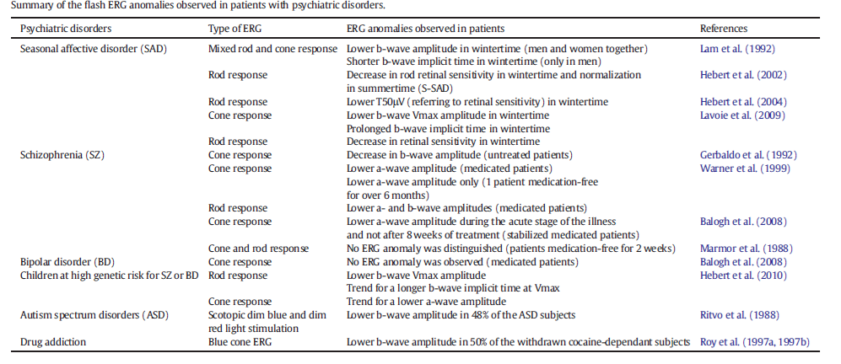
Further Measures to find Psychological Disorders

